Slide 1

Housing Affordability
Melbourne

Slide 2

Objective: Analyze the factors affecting Housing Affordability in Melbourne
Components Contributing to Housing Affordability :
Population-Presenter Hansen
Inflation/Interest Rates-Presenter Mark
School Ranking- Presenter Rakhi
Salary- Presenter Aria

Slide 3
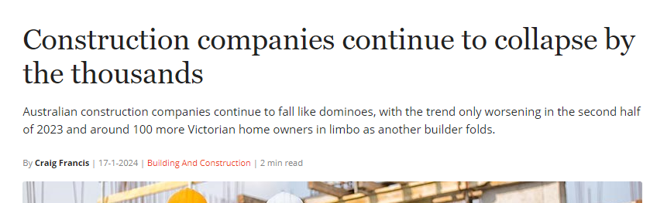
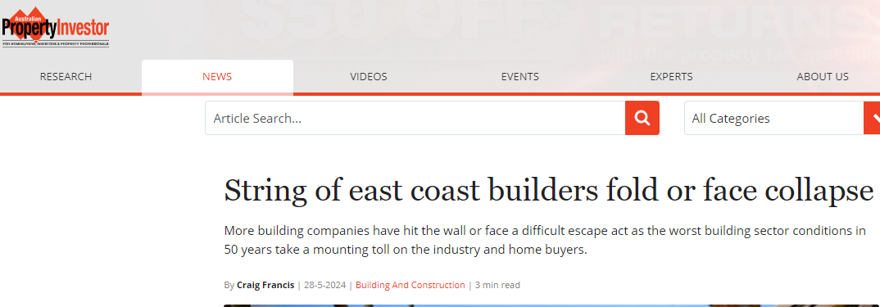
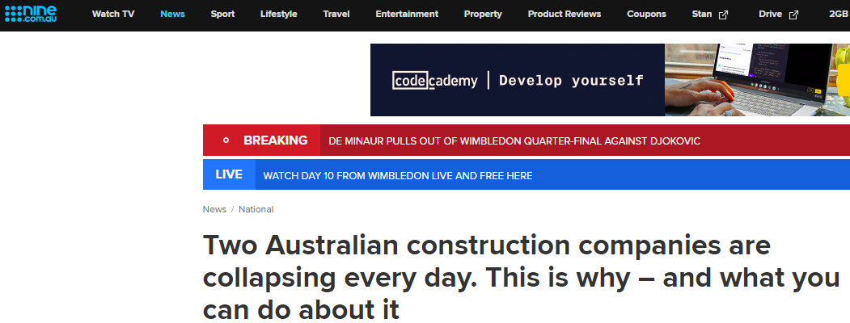
Inflation/Interest Rates-Presenter Mark

Slide 4
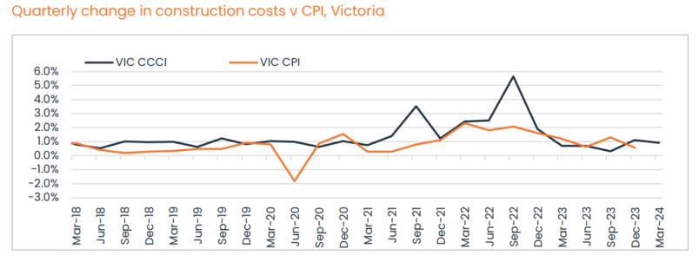
https://propertyupdate.com.au/how-much-on-average-does-it-cost-to-build-a-house/#building-costs-growth-forecast-for-the-year-ahead
Analysis of Melbourne's Housing Crisis: Rising Costs (Inflation), and Interest Rates and Household Debt to Income (2013-2023)
The recent string of construction company collapses in Melbourne has exacerbated the housing crisis by reducing supply and increasing building costs, which have surpassed the Consumer Price Index (CPI). Additionally, high interest rates are making home purchases more difficult and putting pressure on rental properties.
This analysis examines these factors within the context of Melbourne from 2013 to 2023, utilizing a dataset that includes detailed information on house prices, interest rates, and inflation. The study involves data cleaning, exploration, analysis, and visualization to uncover trends and relationships.
Housing Prices and Interest Rates Analysis
The first analysis focuses on identifying the relationship between interest rates and median house prices across Melbourne suburbs from 2013 to 2023. Given the positive skewness of the data (average skewness of 2), it is clear that house prices are heavily influenced by a few high-value properties.
From 2019 to 2023, there are over 30 categories of interest rates (e.g., fixed, variable, investor) provided by the Reserve Bank of Australia (RBA). Historically, these rates do not differ significantly from each other. For instance, the standard variable rate for CBA is 7.14%, compared to a fixed rate of 6.59%. Due to the difficulty in categorizing specific interest rate buckets, we use the average interest rate for a fair assessment. The data, collected at specific dates, represents an average of variable and fixed rates sourced from RBA websites due to data unavailability.
Statistical Analysis
The statistical analysis, particularly focusing on the p-value, shows that the p-value is nearly zero. This indicates a very low probability that the observed differences between interest rates and house prices happened by chance. Consequently, there is strong evidence to reject the null hypothesis, confirming a statistically significant difference between the means of the two datasets. Conclusion
The analysis concludes that high interest rates contribute significantly to the rise in house prices. This relationship, combined with the impact of collapsing construction companies and rising building costs, underscores the complexity of Melbourne's housing crisis. Addressing these issues requires a multifaceted approach, considering both financial and structural factors influencing the housing market.. Out of the 791 locations, only 61 location and lower than the median house price and the rest is above. Hence the average house data is chosen to reflect the current housing market price

Slide 5
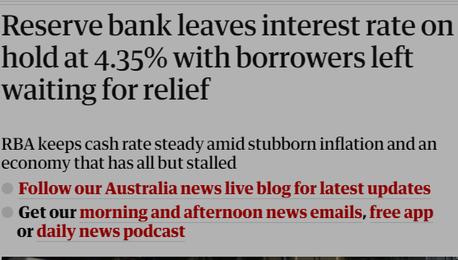
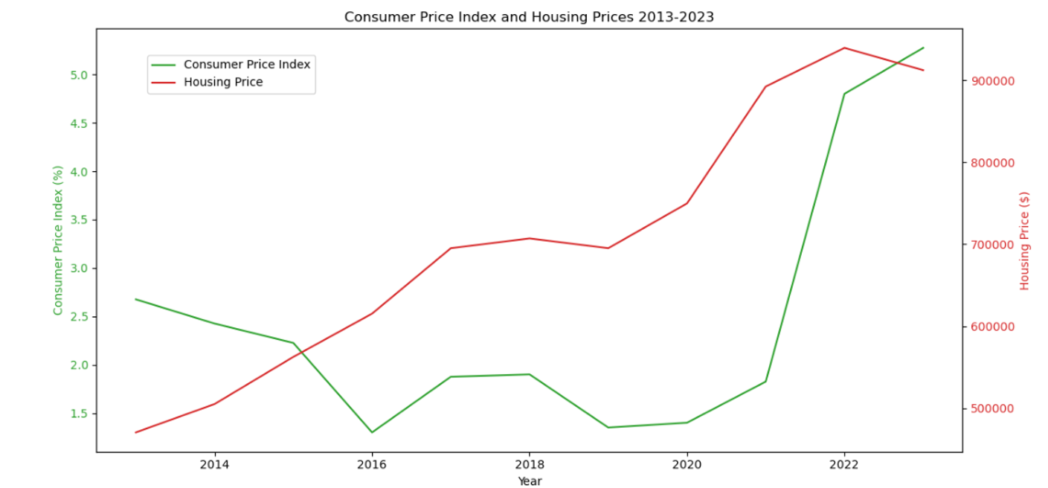
Anticipation for the RBA Cash Rate Decision and Its Impact on Melbourne's Housing Market
On the upcoming 6th of August 2024, at 2:30 PM, Australians are eagerly awaiting the Reserve Bank of Australia's (RBA) decision on the cash rate, which is largely influenced by the inflation rate, also known as the Consumer Price Index (CPI). A 0.5% increase in the cash rate would result in the average Melburnian with a mortgage of $1,000,000 (median house price in 2023 was $912,255) needing to divert $300 per month from their family holiday budget to cover the additional interest costs.
Analysis of Inflation Trends
The average inflation rate in Australia has shown a steady increase from 2.6% in 2013 to 5.275% in 2023. This rising trend in inflation is a critical factor considered by the RBA when setting the cash rate.
Statistical Analysis of Inflation and Housing Prices
Pearson Correlation
The Pearson correlation coefficient between year-ended weighted median inflation and housing prices is 0.495. This value suggests a moderate positive linear relationship, meaning that as inflation increases, housing prices tend to increase as well.
P-value
The p-value associated with this correlation is 0.122. Since this p-value is greater than the common significance threshold of 0.05, we fail to reject the null hypothesis at the 5% significance level. This indicates that there is not enough statistical evidence to conclude that the observed correlation between inflation and housing prices is significantly different from zero.
Conclusion
In conclusion, while there is a moderate positive correlation between inflation (CPI) and housing prices, the statistical evidence is not strong enough to definitively state that CPI significantly contributes to the housing price crisis in Melbourne. The upcoming RBA decision on the cash rate, influenced by rising inflation, will have a direct impact on mortgage costs for Melburnians, highlighting the complex interplay between economic factors and the housing market.

Slide 6
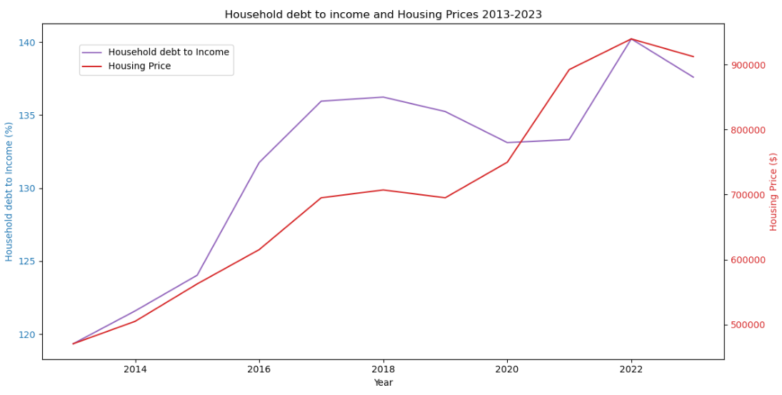
Household debt to income
Statistical Analysis of Household Debt to Housing Price
Pearson Correlation
The Pearson correlation coefficient between household debt and housing prices is 0.858. This value indicates a very strong positive linear relationship between the two variables, meaning that as household debt increases, housing prices also tend to increase significantly.
P-value
The p-value associated with this correlation is 4.79×10−84.79 \times 10^{-8}4.79×10−8, which is much less than the common significance threshold of 0.05. This indicates that the observed correlation is statistically significant. There is strong evidence to reject the null hypothesis, which states that there is no relationship between household debt and housing prices. Therefore, the observed strong positive correlation is very unlikely to be due to random chance.

Slide 7
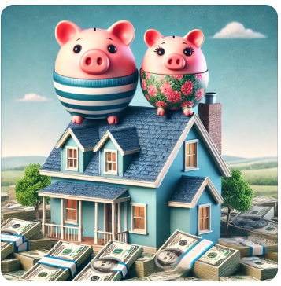
There is hope

Slide 8
Impact of School Rank on Melbourne House Prices Presenter-Rakhi
Data Sources :
Better Education https://bettereducation.com.au/
Property Sales Statistics:
Property sales statistics (land.vic.gov.au)
Testing Techniques:
Hypothesis Testing
Research Questions:
How does the rank of schools within a suburb influence the annual growth rate of house prices
Is there a correlation between the per annum growth of house prices and the school rank of the suburb?
Notes:
This study explores the relationship between the quality of schools, as indicated by their rank, and the dynamics of housing prices and affordability in various suburbs of Melbourne.
We utilized data from reputable sources such as Better Education and Property Sales Statistics from the Victorian government to conduct our analysis.
By applying hypothesis testing techniques, we aim to answer two critical research questions:
How does the rank of schools within a suburb influence the annual growth rate of house prices?
Is there a correlation between the per annum growth of house prices and the school rank of the suburb?
The house prices directly relates to house affordability. When house prices go up, it becomes harder for people to afford to buy a home.

Slide 9
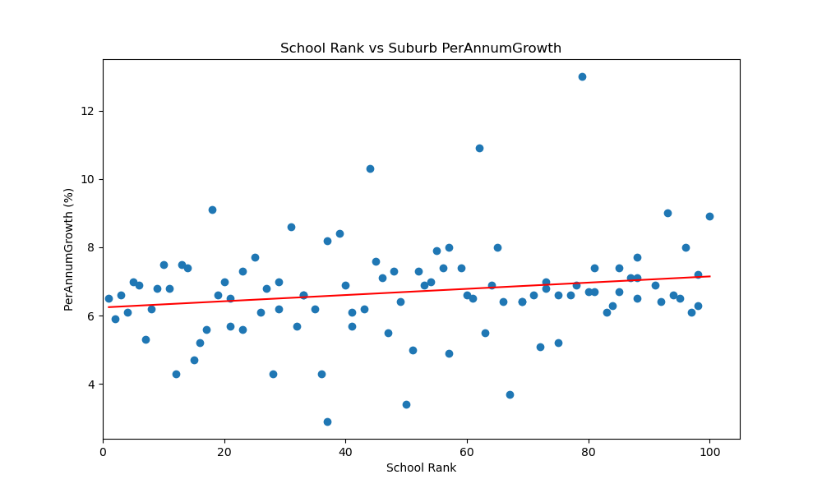
School Ranking Vs Suburb Per Annum Growth
Null Hypothesis (H0): There is no correlation between per annum growth of house prices and the school rank of the suburb. Alternative
Hypothesis (H1): There is a correlation between per annum growth of house prices and the school rank of the suburb.
Pearson correlation coefficient: 0.18743152347370493
P-value: 0.06320660201433415
Notes:
In this slide, we are analysing the correlation between School rank and per annum growth in house price in that suburb.
We created the scatter plot to analyse the relationship between school rank and per annum growth in house prices.
The ​Null Hypothesis in this case is (H₀): there is no correlation exists between per annum annual growth and school rank.​ Alternate Hypothesis (H₁): A correlation exists between annual growth and school rank.​
Per Annum Growth In House Price and School Rank Analysis​
​
Pearson correlation coefficient: 0.1874315234737049​
The correlation coefficient indicates a weak positive relationship between school rank and annual growth.
the correlation is too weak to be considered statistically significant.​ This suggests a slight tendency for improved school rankings to correlate with increased annual growth.
​
P-value: 0.0632066020143343​
The p-value of 0.063 suggests that the correlation observed might be due to random chance., As a result, we fail to reject the null hypothesis, which states that there is no correlation between school rank and annual growth.​
Conclusion is
The analysis indicates a weak positive relationship between school rank and annual growth, but this relationship is not statistically significant.
Further research and analysis are needed to fully understand the dynamics between school rank and house price growth.

Slide 10
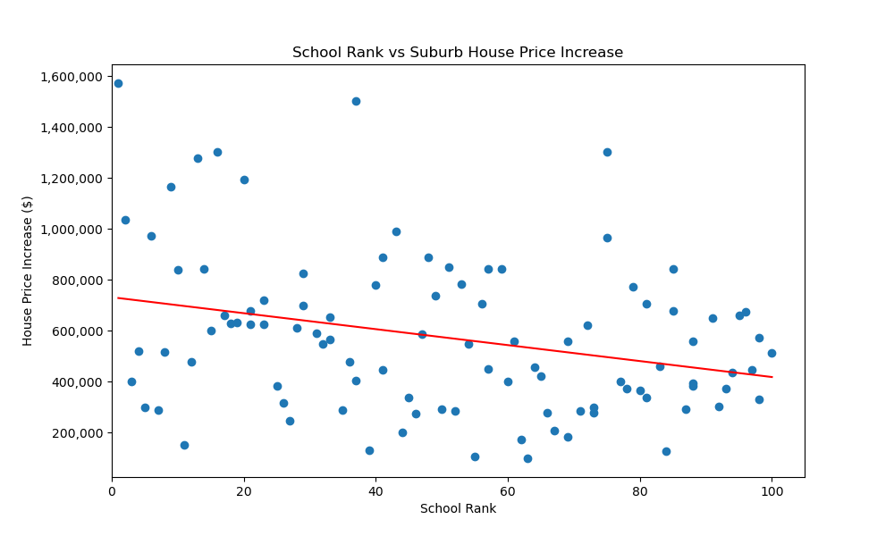
School Ranking Vs House Prices
Null Hypothesis (H₀): No correlation exists between house price growth and school rank.
Alternate Hypothesis (H₁): A correlation exists between house price growth and school rank.
Pearson correlation coefficient: -0.29597163226278067
P-value: 0.0029353964662798466
Notes:
In this slide, we are analysing the correlation between School rank and house price increase in that suburb.
The scatter plot shows the relationship between school rank and house price increase in various suburbs
X-axis is the School Rank (lower values represent better-ranked schools).
Y-axis is the House Price Increase ($).
The red line represents the linear regression trend line, showing a negative slope indicating a negative relationship between the variables.
The Null Hypothesis (H₀) in this case is that there is No correlation exists between house price growth and school rank. ​ ​
Alternate Hypothesis (H₁): A correlation exists between house price growth and school rank.
The Pearson correlation coefficient of -0.296 suggests a moderate negative relationship between school rank and house price increase. This implies that better-ranked schools (lower rank numbers) are associated with higher increases in house prices.
The p-value of 0.0029 is significantly lower than 0.05, indicating that the correlation observed is statistically significant. This means there is strong evidence to reject the null hypothesis, supporting the alternative hypothesis that a correlation exists between school rank and house price growth.
Conclusion: ​In summary, the data suggests that suburbs with better-ranked schools tend to experience higher equity growth, supporting the idea that school rankings have a positive impact on the housing market.

Slide 11
Summary
House price increase is more in good school suburbs
Hose price per annum growth is weakly corelated with school ranking
Good school suburbs are less affordable
Notes:
When house prices go up, it becomes harder for people to afford to buy a home. This is because higher prices mean you need more money to buy a house. For many people, especially those with average incomes, this can make buying a home too expensive.
As house prices increase more significantly in suburbs with good schools, affordability becomes a critical issue. ​
Higher house prices mean that the cost of buying a home in these desirable areas increases faster than in areas with lower-ranked schools. ​
For middle-income families, the rising house prices can make it difficult to afford homes in these areas, potentially limiting access to good public schools based on financial constraints. ​
This can lead to a socio-economic divide where only wealthier families can afford to live in suburbs with the best schools, aggravate inequality in educational opportunities.

Slide 12
Data Sources | Data Preparation | Analysis
Property sales statistics (land.vic.gov.au)

Slide 13
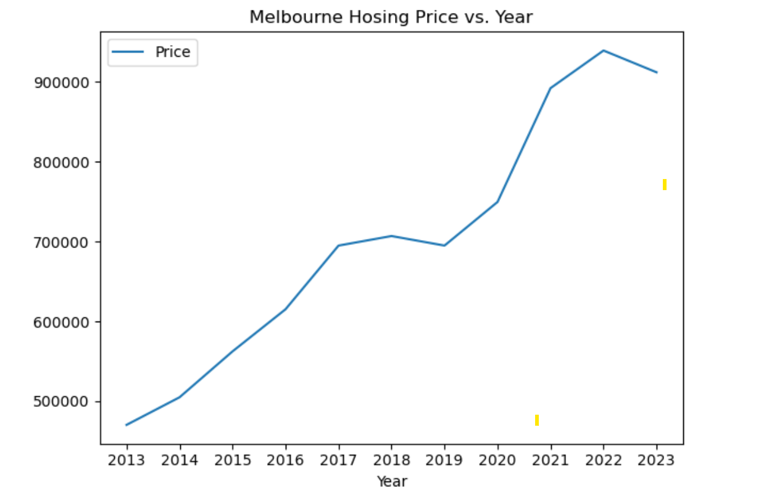
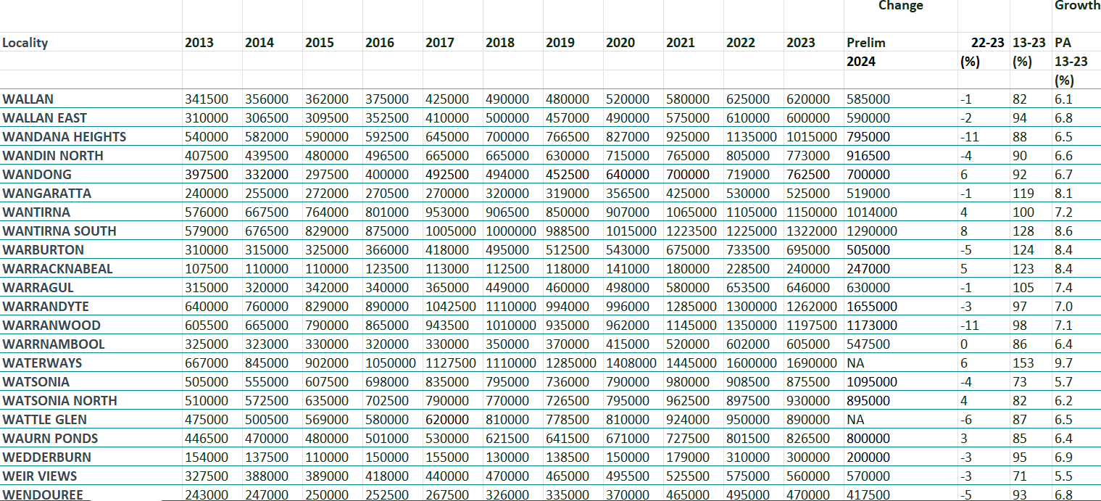
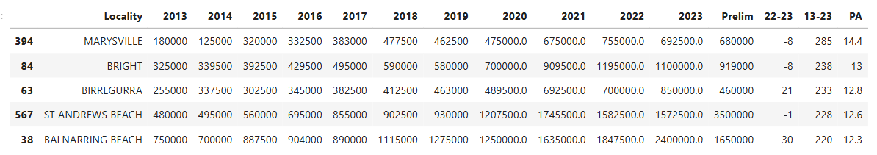
Melbourne Housing Market heat or not
Max 10 Year growth : MARYSVILLE +285%
Min 10 Year Growth: QUAMBATOOK,
Notes:
The data is compiled using information lodged every time a property sale is completed. It provides property statistics for Victoria's 79 municipalities and yearly medians by suburb over a 10-year period.
Over the past 10 year, we have see an increasing trend for all suburbs except for QUAMBATOOK, which has 7 % decrease in growth.
After we have calculated the mean for all surbs, we have created the line chart showing the Melbourne price movement with time. Starting at $470,395.08 in 2013, the median house price for Melbourne has increased to $695,069.46, then the median house price rise slowly and dropped to $695089.00 in 2019.
Interestingly, we see a similar trend from 2019 to 2023, with a steady increase to $939,518.09 then a drop of 9% in the median price. This drop is mainly related to the increase population in 2023 after the pandemic.

Slide 14
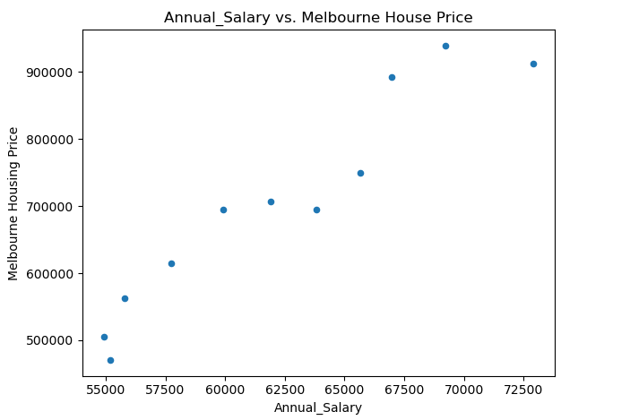
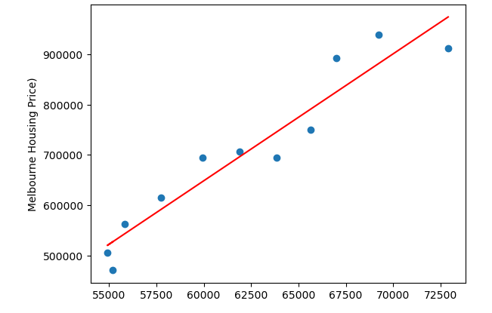
Salary VS Price
y = 25.25x +-866264.94

Slide 15
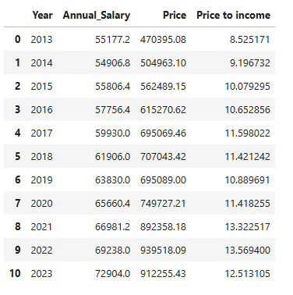
Melbourne House Affordable or not?
Hose Deposit in 30 years:
Annual Salary in 30 years:
Notes:
Housing values have gone from less than three times disposable household incomes in the mid-1990s, to more than 5.5 times incomes, modelling from the Reserve Bank shows.
With property prices continuing to rise against a backdrop of low wage growth, the gap between the two was likely to continue to widen

Slide 16


